Slide 1

SKill MIGRATION
Analysis of Global Skill Group Migration
Krishna Pulipaka, Jan 2021

Slide 2

From my personal story…
Curious if…
A country’s Population, Literacy Rate or GDP Per Capita are predictors of skilled worker migration into/out of the country
And
Can I predict the relative degree of skill group migration?

Slide 3

My Sources
Data Catalog within the worldbank.org:
Skill Migration: Migration of population within several skill groups for every 10,000 users of LinkedIn
Data for 140 countries from 2015 to 2019
Contained net population by ‘Income Group’, ‘Skill Group’ and ‘Skill’
GDP Per Capita value for each country
Literacy Rate for each country

Slide 4

Machine Learning Model:
Multi-variate Linear Regression:
Population
Literacy Rate
GDP Per Capita
Skill Group
Year
Net Value/No Net Value
For a given Year, Country and Skill Group
Model 1
Predict how many people who leave or stay?
y
X variables
Model 2
Will a country experience a Net Gain/Loss?
(Yes-1, No-0)

Slide 5

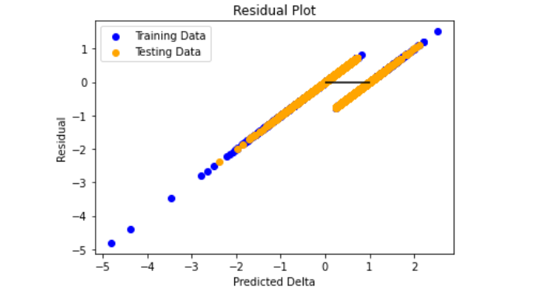
Ridge and Lasso Linear Regression
MODELS SELECTED DID NOT PRODUCE EXPECTED RESULTS

Slide 6

Conclusion
Neither Model 1 nor Model 2 produced predictive values for global skill group migration

